Slide 1
Ionic with OCR Blink

Slide 2
Support format
Use these scanner types
Available: "PDF417", "USDL", "Bar Decoder", "Zxing", "MRTD", "UKDL", "MyKad"
PDF417 - scans PDF417 barcodes
USDL - scans barcodes located on the back of US driver's license
Bar Decoder - scans code39 and code128 type barcodes. Both Code 39 and Code 128 are scanned by default when using Bar Decoder.
Zxing - scans various types of codes (i.e. QR, Aztec). Types of scanned codes can be modified in plugin classes (Explained later in this readme). By default, scanned codes are set to: Code 39, Code 128, EAN 13, EAN 8, QR, UPCA, UPCE
MRTD - scans Machine Readable Travel Document, contained in various IDs and passports
UKDL - scans the front of United Kingom driver's license
MyKad - scans the front of Malaysian ID cards
Variable << types >> declared below has to contain all the scanners needed by your application. Applying additional scanners will slow down the scanning process

Slide 3
Add plugin
Plugin need to download using Git command
Follow the instruction here, https://github.com/BlinkID/blinkid-phonegap
or using working code in this folder

Slide 4
Clone Repo
Since source code is too big so you need to follow as belove.
Copy URL from Clone or download button: https://github.com/BlinkID/blinkid-phonegap.git
Open terminal on Mac/Linux or GitBash on Windows.
cd into directory where you want the cloned directory to be made.
Type git clone , than past URL
Press enter

Slide 5
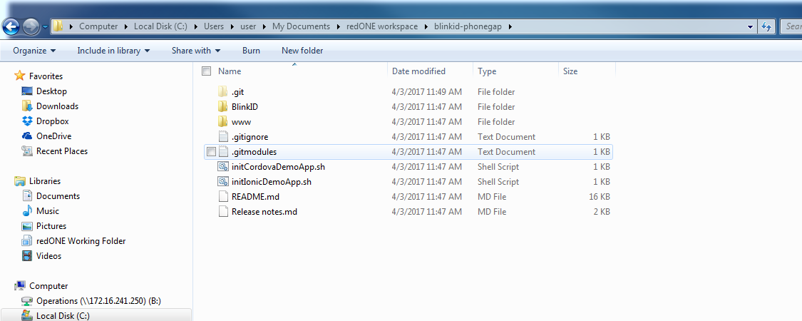
Submodule
Since the previous action only get the folder and some file from git, you need to get the subfolder files as well.
Go into the folder in the previous slide and key in these command
git submodule init
git submodule update

Slide 6
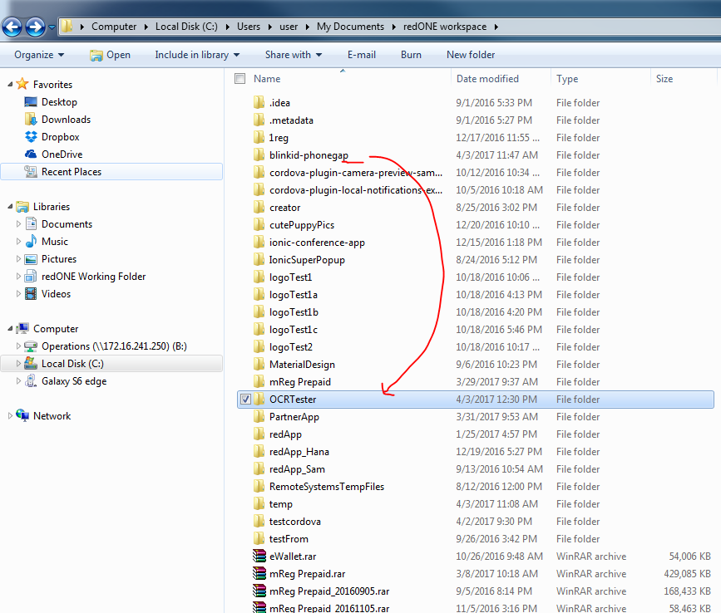
Add the BlinkID lib into your Ionic
Need to add plugin into your ionic project
Cd your project folder
i.e cd OCRTester
Ionic plugin add ../blinkid-phonegap/BlinkID

Slide 7
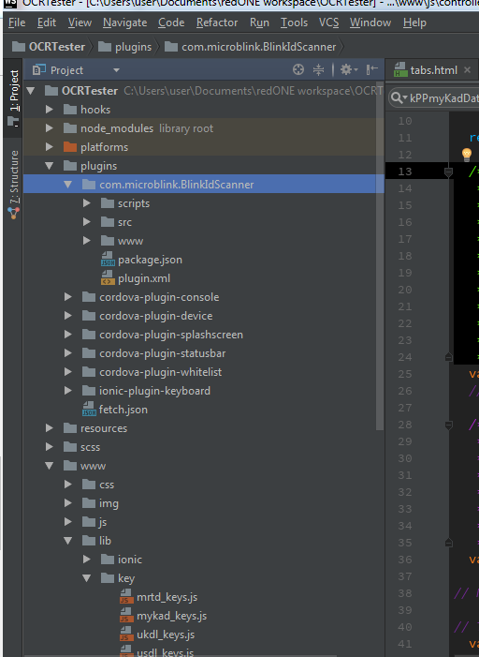
What you should see
You should see as below inside your Ionic project folder
Ionic platform add android
Ionic build android
Ionic run android

Slide 8
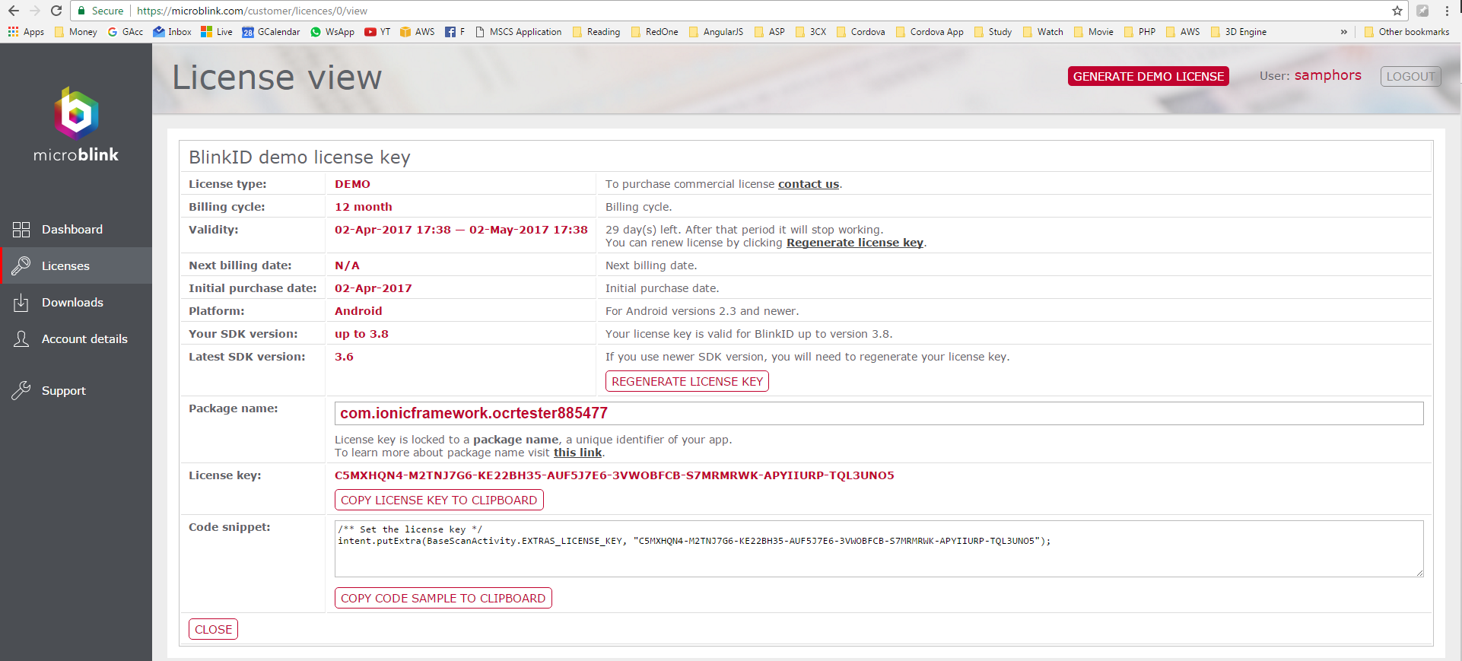
License
You will need a license key, which tie your package ID
Please sign up and get one for testing purpose

Slide 9
Challenge to license key
Package ID of Tunetalk,
ID: com.tunetalk.tunedealer
Key: GJM2KABS-PP4R34QP-E3QKVNKC-ZVEC23PV-XWITBAYW-VRAJEURG-5U32YQES-KI7BUJNZ
Can simulate and use other people license but cannot deploy into Playstore coz Playstore detect unique packge ID
Should the key be stored at backend or at the device?

